Slide 1
Unit 1

Slide 2
Conflict Management
1. What is conflict?
Learning objective: Think about what conflict is
2. What causes conflict?
Learning objective: Improve understanding of the common causes and types of conflicts in and around protected areas
3. Conflict analysis
Learning objective: Gain a foundational knowledge of stakeholder analysis and representation, and common conflict analysis tools; and learn the basic steps of conflict management

Slide 3
1. What is conflict?
Learning objective1: Think about what conflict is

Slide 4
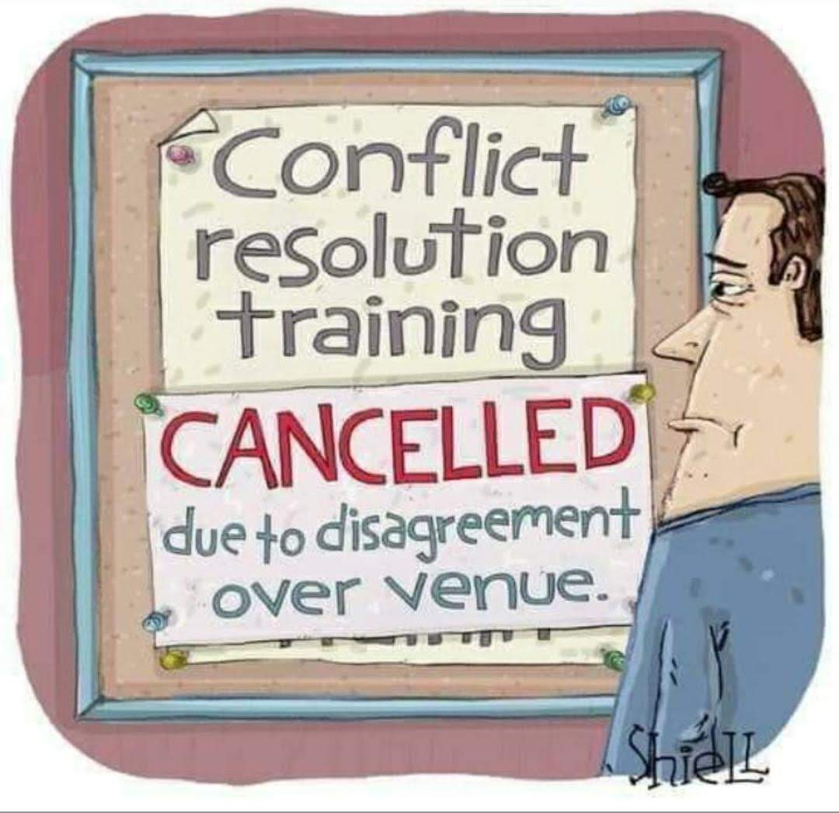
What is Conflict?
“Conflict is a relationship between two or more parties (individuals or groups) who have, or think they have, incompatible goals and who act on the basis of those perceived incompatibilities”, Schneider et al, 2016
Schneider et al 2016, p144

Slide 5
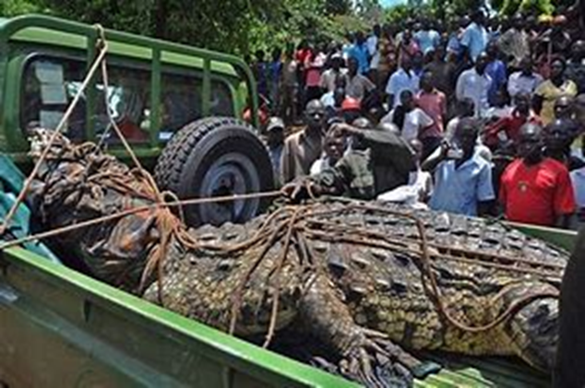
What is Conflict?
Conflict is not the same as violence – conflict is not always violent, or even immediately obvious
Conflict often accompanies change; of course this means it occurs around conservation interventions, especially where resource access or availability is impacted
Generally seen as negative, but this need not be the case, provided the conflict is acknowledged, understood, and transformed into a positive force for change

Slide 6
Types of conflict
Compatible goals
Incompatible goals
Compatible behaviour
No conflict
Latent conflict
Incompatible behaviour
Surface conflict
Open conflict
From Tearfund (no date)

Slide 7
Types of conflict
Compatible goals
Incompatible goals
When goals and behaviour are compatible, there is no conflict
Compatible behaviour
No conflict
Latent conflict
Incompatible behaviour
Surface conflict
Open conflict
From Tearfund (no date)

Slide 8
Types of conflict
Compatible goals
Incompatible goals
Latent conflict is when behaviour is apparently compatible, but goals are not. The latent conflict may need to be brought to the surface to be resolved
Compatible behaviour
No conflict
Latent conflict
Incompatible behaviour
Surface conflict
Open conflict
From Tearfund (no date)

Slide 9
Types of conflict
Compatible goals
Incompatible goals
Compatible behaviour
No conflict
When goals are compatible but behaviour is not, this results in surface conflict. This kind of shallow conflict can often be resolved with good communication
Latent conflict
Incompatible behaviour
Surface conflict
Open conflict
From Tearfund (no date)

Slide 10
Types of conflict
Compatible goals
Incompatible goals
Compatible behaviour
No conflict
Latent conflict
Open conflict is both visible and deep-rooted, emerging from incompatible goals and behaviour
Incompatible behaviour
Surface conflict
Open conflict
From Tearfund (no date)

Slide 11
2. What causes conflict?
Learning objective 2: Improve understanding of the common causes and types of conflicts in and around protected areas

Slide 12
Group exercise: What are the common causes of conflict around protected areas in Uganda?
(case study)
5 minutes to brainstorm examples of conservation conflicts in Uganda
In groups, list the conflicts you have experienced on a flipchart, (keep this as you will refer to this later) and select one person from each group to share with everyone

Slide 13
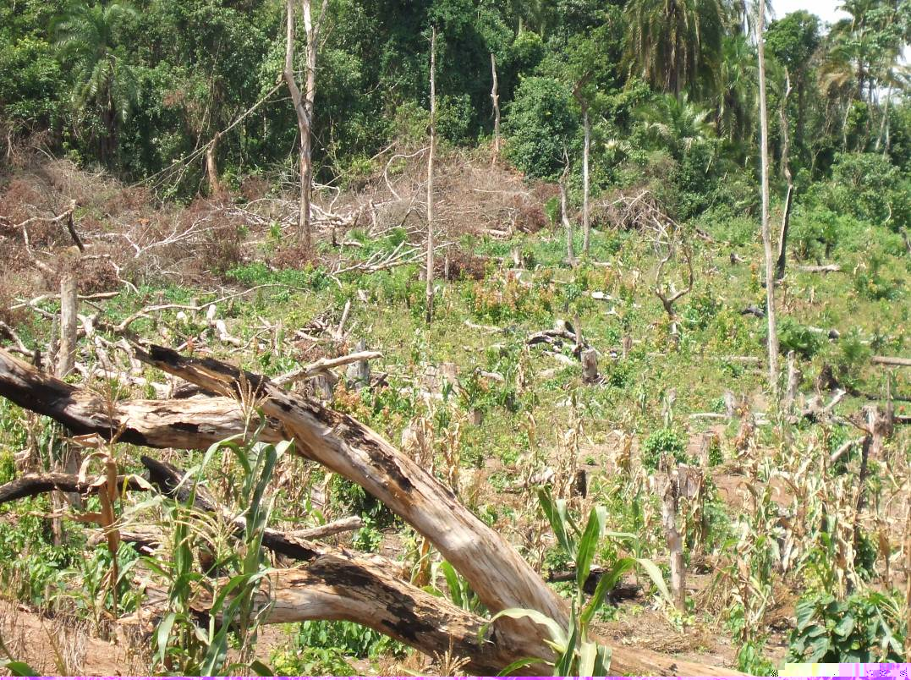
Diverse interests and different values attached to nature...
Does this picture show...
Haven for endangered species?
Rain formation/climate control?
Beautiful landscape, tourism $?
Timber? Fuelwood?
Somewhere to cultivate, graze, fish?
Employment?
Honey, fruit, meat, medicine?
Cultural or sacred space?
Minerals, gas?

Slide 14
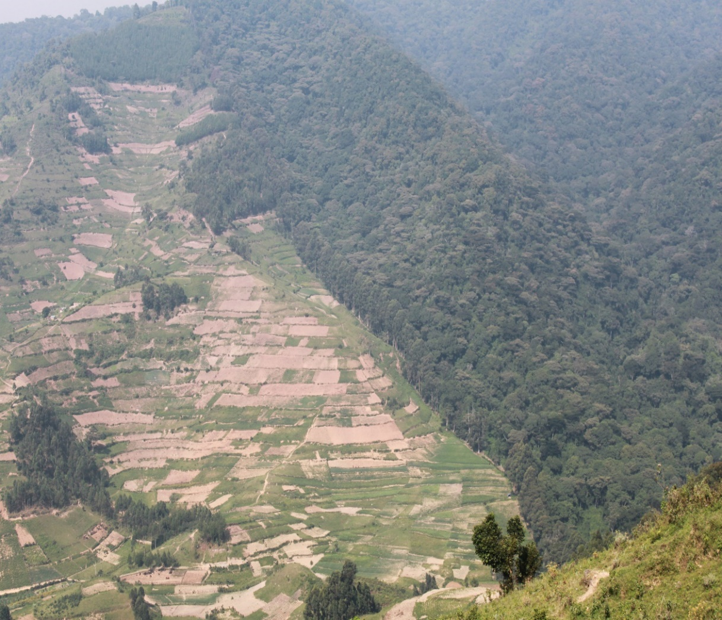
...can lead to competition over limited resources...
Communities
Conservation orgs
Private sector
Central government
Local government

Slide 15
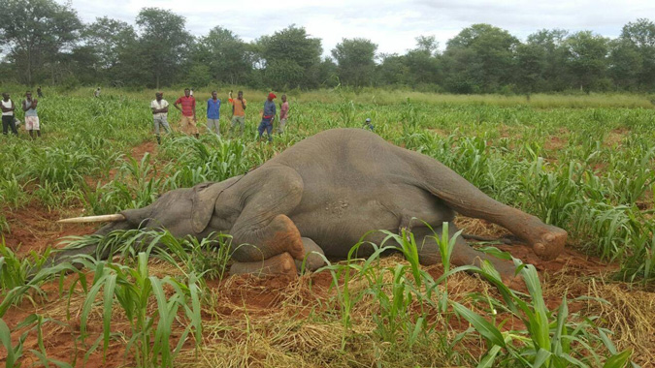
...which is shaped by power dynamics and actor relationships
  Imagined or actual imbalances of power
  Limited involvement of local people in PA decision-making processes
  Resource use restrictions (justified or not?)
  Heavy-handed law enforcement
  Perceptions of marginalisation of certain groups (e.g. the poor, front-line communities, ethnic minorities)

Slide 16
Diverse interests and different values attached to nature can lead to competition over limited resources, which is shaped by power dynamics and actor relationships
Institutional failings can contribute to conflict through:
  Poor communication – breeds mistrust
  Corruption and discrimination
  Inequitable distribution of costs and benefits of conservation
  Inadequate support (e.g. in dealing with human-wildlife conflict)
  Lack of monitoring of and reporting on activities
  Lack of presence on the ground

Slide 17
Conflict case study: Governance in Lake Mburo National Park
“...women and men in the communities that border LMNP are concerned that wild animals leave the park and pose a risk to their lives or the lives of their families through death or injury. Wild animals also inflict damage on crops and can kill livestock... All actors highlighted that there is no official compensation policy in Uganda, but households may receive a small payment known locally as ‘compassion’ at the discretion of park officials”
Franks and Booker (2018), Governance Assessment for Protected and Conserved Areas (GAPA), p34

Slide 18
3. Conflict analysis
Learning objective 3: Gain a foundational knowledge of stakeholder analysis and representation, and common conflict analysis tools; and learn the basic steps of conflict management

Slide 19
Identifying the source of conflict
Thinking about what kind of conflict you are dealing with, and identifying the source(s) of the conflict, is an important first step in conflict analysis. The more information you have about the cause of the conflict, the more easily you can help to resolve it.
What kind of conflict is it?
  Open?
  Latent?
  Surface?
What is the problem?
  Sources and triggers?
  Direct and underlying causes?

Slide 20
Group Activity: Types of Conflict
In groups, identify one example of conflict from the brainstorming exercise on Slide 13, and think about:
  What type of conflict is it? (latent, surface, open)
  What were the sources of conflict?
  Were there any particular triggers that shifted latent conflict into open conflict…..
  or
  Are there triggers that transformed surface or open conflict into no or latent conflict?

Slide 21
Group Activity: Types of Conflict
Possible sources of conflict might be:
Conflicting interests or values
Difficult relationships or behaviours (historical or new)
Actual or perceived inequality or injustice
Lack of clarity over rules, regulations, rights or responsibilities

Slide 22
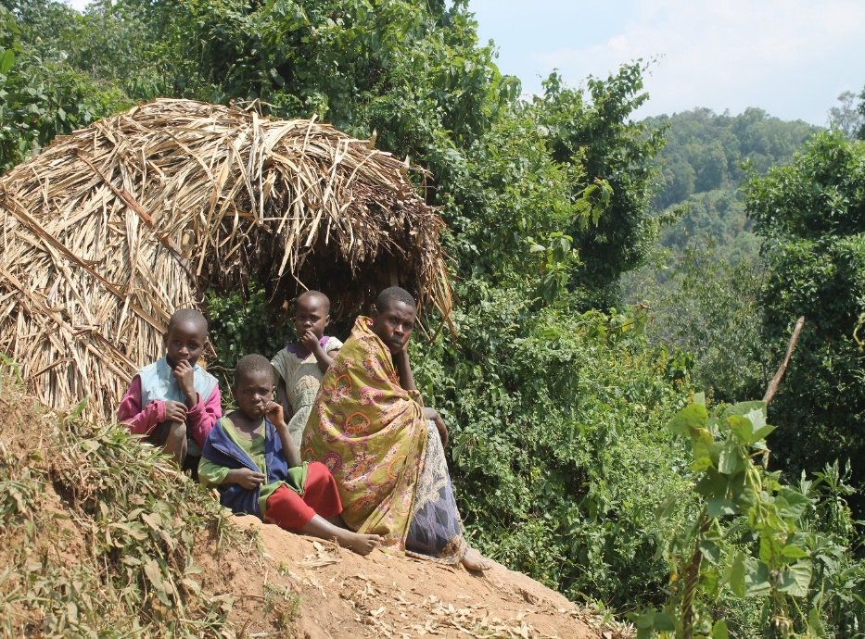
Then think about stakeholder identification...
Conflict management is based on the participation of the people who are involved in the conflict – the stakeholders. You need to know who all the stakeholders are in order to analyse and manage the conflict effectively
Remember to look out for and involve weaker, less visible or marginalized stakeholders
      Women
  The poor
  Immediate protected area neighbors
  Remote communities
  Protected area resource collectors
  Ethnic minorities
  Etc.

Slide 23
...and stakeholder representation
In complex multi-stakeholder conflict with a large number of stakeholders, full participation of every single stakeholder is not practical
In such cases, stakeholders not directly involved in conflict analysis or management need to be clear on how they will be represented in the conflict management process (e.g. at workshops)
This will likely involve the selection of stakeholder representatives

Slide 24
Using stakeholder group representatives in conflict management processes
Remember that any UWA involvement in facilitating selection of stakeholder representatives will have implications!
Best scenario is if stakeholders decide this themselves
But this is not always possible....

Slide 25
Using stakeholder group representatives in conflict management processes
If UWA is helping in stakeholder representative selection, representatives should:
Be recognized as legitimate by their groups
Have authority to negotiate for their group
Communicate clearly, frequently with group
Be able to:
  Talk to other stakeholders
  Negotiate
  Understand important information
Operate transparently
Have time to participate in the process
Ideally, a group would have more than one representative – to aid transparency, share responsibility, help remember details, maintain trust within the group, and to enable continuation of the conflict resolution process if one representative is unavailable

Slide 26
Case study: Perceived inequity in distribution of costs and benefits of conserving Bwindi National Park
Perceived unfair distribution of protected area benefits e.g. revenue sharing
Perceived inequity in access to protected area benefits e.g. employment as shown on the graph
Namara 2015

Slide 27
Case study: Perceived inequity in distribution of costs and benefits of conserving Bwindi National Park
Middle and senior managers mainly not from frontline villages
90% of employees from 5 out of 27 park adjacent parishes
80% of employees from frontline villages from 8 out of 100 villages
Namara 2015

Slide 28
Case study: Perceived inequity in distribution of costs and benefits of conserving Bwindi National Park
Perceived unfair distribution of protected area benefits e.g. revenue sharing
Perceived inequity in access to protected area benefits e.g. employment
Middle and senior managers mainly not from frontline villages
90% of employees from 5 out of 27 adjacent parishes
80% of employees from frontline villages from 8 out of 100 villages
Who are the stakeholders in this (potential) conflict?
Namara 2015

Slide 29
Recognizing diversity and engaging multiple stakeholders
  Builds legitimacy
  Generates innovative solutions
  Enhances transparency
  Promote achievement of complementary goals
  Enhances social equity

Slide 30
What conflict analysis tools can we use?
Having identified your stakeholders, and thought about how they will be represented in the conflict management process, you can begin to plan how to analyse and understand the conflict
Tool | Use to...
Impacts Matrix | Select priority conflict
Feasibility Matrix | Select priority conflict
Conflict Tree | Identify causes and effects of conflict
Conflict Mapping | Identify key conflict actors and the relationships between them
PINs Analysis Table | Reveal actors’ interest and needs driving conflict
Participation is key!

Slide 31
Selected conflict analysis tools
These are some of the tools that could be used in a conflict analysis workshop:
Impacts matrix
Feasibility matrix
Conflict tree
Conflict mapping
PINs analysis table
This section gives an overview of each tool. Check references on slide 66 for further study

Slide 32
Selected conflict analysis tools
These are some of the tools that could be used in a conflict analysis workshop:
Impacts matrix
Feasibility matrix
Conflict tree
Conflict mapping
PINs analysis table
Ideally these tools would be used as part of a participatory conflict analysis process at e.g. a workshop attended by all relevant parties!
This section gives an overview of each tool. Check references on slide 66 for further study

Slide 33
Identifying priority conflicts: Impacts Matrix
High priority conflict: Carry through for further analysis
Medium priority conflict: Carry through for further analysis if extra resources are available
Low priority conflict: Consider for further analysis in future – no immediate need
 | Impacts Matrix: High-, medium- and low-priority conflicts
Conservation Impacts | Human Impacts
 | High | High | Medium | Low | None
 |  | Illegal resource extraction by armed groups in the park |  | Encroachment into the park for agriculture
 | Medium |  | Village grievances over absence of revenue-sharing
 | Low
 | None
Good tool for identifying which instances of conflict should be prioritised, based on highest impact on both conservation and communities
Adapted from IISD 2009

Slide 34
How feasible is this: Feasibility Matrix
Summary of prioritised conflicts, potential impact and feasibility
Prioritised conflict | Impacts | Feasibility | Notes
Encroachment into the park for agriculture | Medium | High | Low risk to staff, within mandate, building on existing partnerships
Illegal resource extraction by armed groups in the park | High | Low | High risk to staff, requires too many resources, need more strategic partnerships (e.g. military, police)
Simple tool for working out and visualizing where the best opportunity for intervention lies – if any!
IISD 2009

Slide 35
How feasible is this: Feasibility Matrix
These questions will help you think through whether it’s feasible for UWA to become involved in a conflict:
Does this conflict fall within UWA’s remit?
Is there any personal risk to staff or beneficiaries from intervening?
How will local support for UWA be impacted by UWA intervening, or not intervening?
Can key stakeholders realistically participate?
Do we have the resources (financial, technical, human) to address this conflict?
Are there any partnerships we have, or we can form, to help us address this conflict?

Slide 36
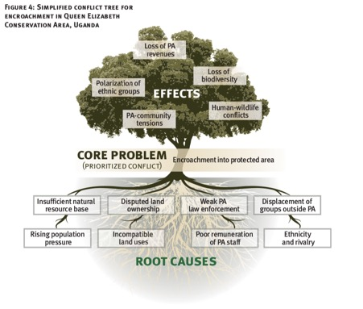
Cause and effect: Conflict Tree
Good tool for use in workshops, to get perspectives from all stakeholders
Simple and effective way to separate out and visualise the causes and effects of the prioritised conflict
IISD 2009

Slide 37
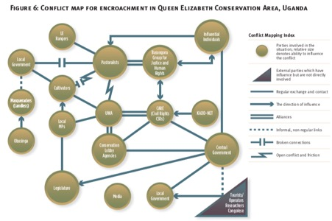
Actor relations: Conflict map
Use a conflict map to visualise actor relations after you have identified your priority conflict and key stakeholders
Include all key stakeholders as identified at the beginning
Different lines show different kinds of relationships and directions of influence
IISD 2009

Slide 38
Actor motivations: Positions, Interests, Needs (PINs)
Thinking in terms of Positions, Interests and Needs can help us to separate what people say about a conflict situation, and why they say it
Positions are the vocalisation of a desire – the thing(s) stakeholders say they want. Underlying the position is the interest
Interests are the underlying motivations that inform the position. Positions are vocalised, but interests might not be. So it is important to determine what someone’s interests are – you might find that they have some common ground with those that they are apparently in conflict with, and can then find flexibility in their position
Needs are the things that are essential for survival or satisfaction

Slide 39
Actor motivations: Positions, Interests, Needs (PINs)
Stakeholder 1
Stakeholder
2
Positions
What we state
Interests
What we want
Needs
What we must have
Areas of mutual interests and needs
Adapted from WHO (n.d.)

Slide 40
Actor motivations: Positions, Interests, Needs (PINs)
How can you complete this table to identify the PINs of these two different stakeholder groups?
Uganda Wildlife Authority | Basongora pastoralist lobby group
Positions | Positions
Interests | Interests
Needs | Needs
Simplified from IISD 2009, p47

Slide 41
Actor motivations: Positions, Interests, Needs (PINs)
Uganda Wildlife Authority | Basongora pastoralist lobby group
Positions PA boundaries must be respected No settlement or encroachment should be permitted within the PA | Positions Basongora are a marginalised group PA is on ancestral land and should be returned to Basongora
Interests | Interests
Needs | Needs
Simplified from IISD 2009, p47

Slide 42
Actor motivations: Positions, Interests, Needs (PINs)
Uganda Wildlife Authority | Basongora pastoralist lobby group
Positions PA boundaries must be respected No settlement or encroachment should be permitted within the PA | Positions Basongora are a marginalised group PA is on ancestral land and should be returned to Basongora
Interests Protection of biodiversity | Interests Political representation Sustainable livelihoods
Needs | Needs
Simplified from IISD 2009, p47

Slide 43
Actor motivations: Positions, Interests, Needs (PINs)
Uganda Wildlife Authority | Basongora pastoralist lobby group
Positions PA boundaries must be respected No settlement or encroachment should be permitted within the PA | Positions Basongora are a marginalised group PA is on ancestral land and should be returned to Basongora
Interests Protection of biodiversity | Interests Political representation Sustainable livelihoods
Needs Preservation of PA’s ecological value Tourism income | Needs Access to land Recognition and respect of identity
Simplified from IISD 2009, p47

Slide 44
Group reflection: PINs
How useful do you find it to distinguish between positions and interests?
To what extent do you think it would be useful to use this tool in a ‘real’ situation with stakeholders in a (potential) conflict situation?

Slide 45
Group reflection: PINs
How useful do you find it to distinguish between positions and interests?
To what extent do you think it would be useful to use this tool in a ‘real’ situation with stakeholders in a (potential) conflict situation?
Ideally a PINs exercise should help identify mutual interests and needs underlying the apparently conflicting positions of different groups, uncovering some ‘common ground’ on which to negotiate

Slide 46
Remember, whichever tools you use in conflict analysis, understanding the conflict is only the first step. Always return to your analysis and think about how your work as a community conservation warden contributes to the issues identified – whether positively or negatively
What conservation activities are you undertaking? |  | Is your work: Addressing shared interests, fears, needs? Reinforcing existing capacities that positively influence the conflict? Filling key capacity gaps?
IISD 2009

Slide 47
For a conflict workshop, IISD suggest attendance from the following:
Workshop facilitator
Rapporteur
UWA senior management
UWA field staff
Other relevant NGOs (conservation and otherwise)
Consultants/researchers (if applicable)
...and communities OR their selected representatives!
IISD 2009

Slide 48
For a conflict workshop, IISD suggest attendance from the following:
Ask the stakeholders who should be involved in conflict analysis and management processes!
Workshop facilitator
Rapporteur
UWA senior management
UWA field staff
Other relevant NGOs (conservation and otherwise)
Consultants/researchers (if applicable)
...and communities OR their selected representatives!
IISD 2009

Slide 49
What is conflict management?
Actions, responses, processes and systems that help prevent, identify, handle and manage conflicts in sensible, fair, peaceful, meaningful and efficient/effective manner

Slide 50
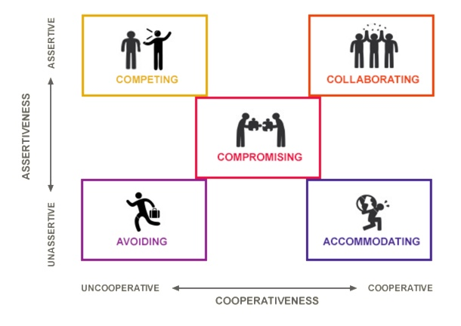
Conflict management strategies
Which of these strategies are suitable and not suitable for you?
avoiding,
defeating,
compromising,
accommodating, and
collaborating

Slide 51
Conflict management: checklist of basic steps
  Conflict analysis
  Problem and causes or sources of conflict
  Stakeholder identification
  Identification and understanding, PINS
  Identify solutions; engage stakeholders, sensitization, awareness
  Identify solutions both disputants can support
  Agreement
  Execute agreement
We have covered the components of Step 1 earlier in this section

Slide 52
Conflict management: Step 2 of 4
Identify solutions
Processes which can support conflict resolution include:
Consultation – decision-makers meet with interested stakeholder representatives to receive views on an issue
Dialogue – stakeholders are supported in direct communication with each other to achieve better understanding of each others’ respective perspectives
Negotiation – two or more parties have a structured dialogue about a conflict, to identify possible options for resolution together
Mediation – Like negotiations, but with a dedicated third party acting as a mediator to help parties clarify the problem and identify potential resolutions
These processes can be conducted in e.g. one-off dedicated workshops, or regular committee meetings.
IISD 2009, p52

Slide 53
Conflict management: Step 2 of 4
Identify solutions
When identifying solutions remember these strategic considerations
Motivation
Benefits/incentives
  Reduced costs
  Improved livelihoods
  Removal of negative impact
  New opportunities
2) Interests and needs (think about tools for conflict analysis)

Slide 54
Conflict management: Step 3 of 4
Execute agreement
The agreement is where parties involved in the conflict will formalize their commitments to resolving the conflict
The mediator should aim for parties to shake hands and agree to an alternative identified in Step 2: Identify Solutions
The mediator then writes up a contract in which necessary actions and agreed time frames are specified for the conflicting parties
The contract could take the form of e.g. a set of resource use agreements, or water user committee rules

Slide 55
Conflict management: Step 4 of 4
Execute agreement
Resources needed:
  Financial
  Human
  Logistics
  Knowledge of local context
  Interpersonal and communication skills

Slide 56
Monitoring
  You should monitor any conflict management measures taken
  You can refer to Module 8: Monitoring and Evaluation for more information on monitoring conflict management activities

Slide 57
Monitoring
High priority conflict: Carry through for further analysis
Medium priority conflict: Carry through for further analysis if extra resources are available
Low priority conflict: Consider for further analysis in future – no immediate need
 | Impacts Matrix: High-, medium- and low-priority conflicts
Conservation Impacts | Human Impacts
 | High | High | Medium | Low | None
 |  | Illegal resource extraction by armed groups in the park |  | Encroachment into the park for agriculture
 | Medium |  | Village grievances over absence of revenue-sharing
 | Low
 | None
This is an example of a monitoring tool, based on the Impacts Matrix on Slide.
Use it to see if your interventions helped move the conflict into a lower impact area?

Slide 58
Key skills for conflict management by community conservation wardens
Self-awareness: acknowledge our own biases and think about how our actions may be perceived in different contexts
Do not ignore power imbalances between stakeholders in a conflict, and actively look for weaker/less visible stakeholders
Use our own (usually higher!) power positively, by giving voice to weaker/less visible stakeholders
Use your communication skills! Active listening is particularly important (see Module 2: Effective Communication)

Slide 59
Don’t forget to think about gender in any step of conflict management – women and men experience conflict differently! See Module 5: Undertaking Gender Assessments for Conservation for more on gender assessment

Slide 60
“a good conflict resolution process is one in which stakeholders...have the opportunity to really understand each other’s needs, develop a range of alternatives for how to address those needs, and reach a mutually agreeable solution. The emphasis is on communication” (Lewis 1996)

Slide 61
To sum up...
Conservation can and does contribute to conflict
Conflict can lead to positive change
All conservation activities should be conflict-sensitive – the tools in this training can be used to help manage conflict at any stage, including before conflict has emerged!

Slide 62
To sum up...
There are tools available to help us understand and manage conflict – see references for resources!
As community conservation workers we must be aware of our own biases and positions of power

Slide 63
Don’t forget!
Turn to the Work Plan in your training manual and think about your key learning from today, and how you might apply it in practice!

Slide 64
Conflict Resolution
Positive and Negative Techniques

Slide 65
What is Conflict?

Slide 66
Conflict
1. to come into collision or disagreement; be contradictory, at variance, or in opposition; clash:
2. to fight or contend; do battle.
3. a fight, battle, or struggle, esp. a prolonged struggle; strife.
4. controversy; quarrel: conflicts between parties. 5. discord of action, feeling, or effect; antagonism or opposition, as of interests or principles: a conflict of ideas.
6. a striking together; collision.

Slide 67
What Doesn’t Work?
Yelling, refusing to change or compromise, refusing to work out the conflict,
name calling, hitting, walking out, belittling, etc.
What Does Work?
Negotiation, Mediation, Looking at both sides, A Win-Win attitude.

Slide 68
When is Conflict Positive?
When we are able to resolve internal and interpersonal conflicts,
using win-win problem solving.
Every relationship will have some conflicts at some time or other.
when we use win-win problem solving, it strengthens the relationship.
when we don’t, it destroys it.

Slide 69
Who Owns the Problem?
The person who is negatively affected by the Problem.
What is the Owner’s responsibility?
To find a way to resolve the problem, even if he is not the
cause of it.

Slide 70
Search for Win-Win Solution
The Use of Power
Three Responses
Fight
Flight / Avoidance
Obedience/ Shutting Down
Identify Each Others Needs and Goals

Slide 71
Preparation
Include only those concerned.
Give a description of the problem that respects all involved.
Explain how conflict resolution can enable all to win, and explain the steps.
Agree not to slip back to the win lose methods
Find a good time and place with no distractions.
Get something to write down ideas.

Slide 72
Identify the problem or issues
Use “I” Messages to explain your own concerns, needs and basic goals
Use reflective listening to hear and acknowledge the other’s needs and basic goals
Evaluate exactly what each of your actual needs are with the problem. List needs.
Don’t accept sudden promises not to cause the problem

Slide 73
Brainstorm All Possible Solutions that meets both people’s needs
Cake Cutting Exercise
You are in charge of a Birthday party for four Children. You have one
Cake and need to cut it in 4 equal parts. Brainstorm with your partner
How many different ways you could cut it.
Car Sharing Solution
You and your spouse have one car. You need to go to a meeting
tonight, and your spouse wants to visit a good friend. How many
solutions can you come up with?
Look at things from another’s perspective and try to see their point
of view and look for a solution that meets both underlying needs.

Slide 74
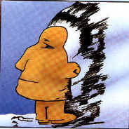

Slide 75


Slide 76


Slide 77


Slide 78


Slide 79
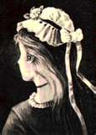

Slide 80


Slide 81
Brainstorm to Generate all possible solutions.
• Think of any and all possible ways to solve the problem so that everyone will have needs met.
• Evaluate later NOT NOW
• Do not criticize any suggestion. Feed back with reflective listening
• Write down all ideas suggested.

Slide 82
Evaluate the alternative solutions
Ask “Will it work? Does it meet all the needs of both people? Are there any problems likely?”
Don’t accept solutions for the sake of speed
Use reflective listening and I Messages

Slide 83
Decide on the best solution.
Find a solutions that is mutually acceptable to both of you. .
If agreement seems difficult, Summarize areas of agreement. Restate needs, and look for new solutions.
Make certain that both of you are committed to the solution

Slide 84
Implementing the Solutions
Get Agreement on who does what by when
Write this down and check all agree to it
Refuse to remind or police the solutions
If you want to set criteria for success, work out these now

Slide 85
Follow-up evaluation
Carry out agreed method. Wait to see if the conflicts seems resolved.
If the agreed upon solution doesn’t work, remember it is the solution that failed, not the person, and seek for a new solution.
Ask from time to time if the solution is working for both of you.

Slide 86
Remember to use I-Messages
and Reflective Listening!

Slide 87
Results of Win-Win Solutions
More creative in Thinking up solutions
Take more responsibility for helping everyone
have needs met
Feeling of mutual respect
Love grows deeper with every conflict resolved.

Slide 88
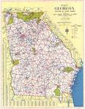
Communication One-Way Map
Communicating thoughts and feelings in a positive way during a heated conflict is often difficult. The following map will help to guide you along the communication I-way. Practice will help you master the "I-way." Before getting on the communication I-way, it is important to learn which signs to look for and to understand a few rules of the road in conflict management.

Slide 89


Rules of the Road:
No "You" statements. Use statements that begin with the word "I". Do not use statements that include the word "you," because these statements make people feel defensive.

Slide 90
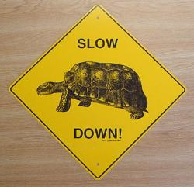
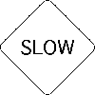
Slow. Remember, it takes time to settle a conflict. Go slow at first, because conflict resolvers usually encounter some rough roads in the beginning. Keep using your I-way map to reach safer roads

Slide 91

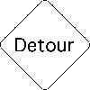
Detour Ahead. Sometimes tempers are flaring so much that it may be necessary
to take a temporary detour from the communication
I-way.
Once the tempers have calmed down, you may
begin using I statements to solve the problem.

Slide 92


Exit Ahead. Most conflicts can be resolved through effective communication. However, if you begin to feel threatened or unsafe, you should exit the communication I-way and seek safety.

Slide 93


Construction Zone. Construct an I-way statement
by following these directions:
• use the word "I"
•state how you feel
•state the specific behavior that you do not like
•state your willingness to cooperatively resolve the problem

Slide 94

Merge Ahead. After using properly constructed I-way statements, individuals can begin to share ideas for how to solve the problem. Often, the best solution is reached when two people merge their ideas together

Slide 95

End of Construction. After reaching a solution that the two individuals agree will work, they can resume normal activities.

